Slide 1
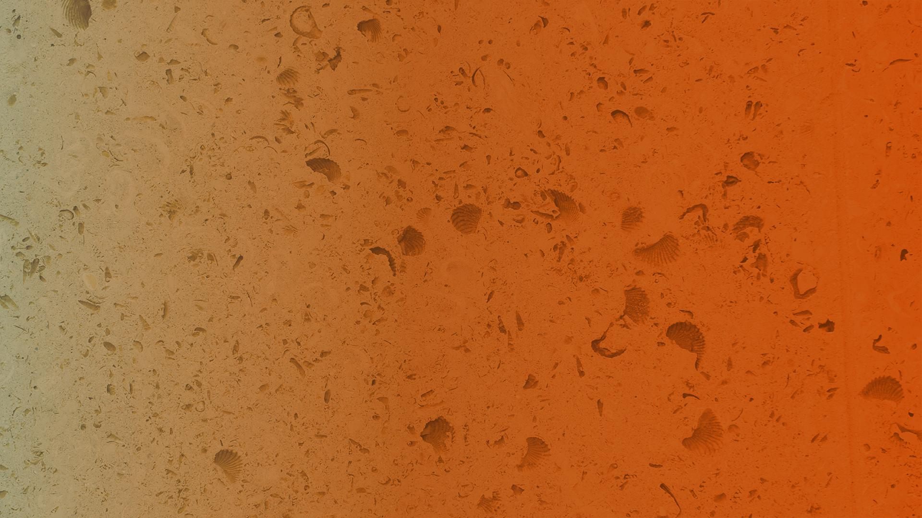

FEBRUARY 28, 2019
CRITIQUE: Mitigating Unwanted Biases with Adversarial Learning
Zhang, B., Lemoine, B., & Mitchell, M.
Critique presented by
Marius Arvinte, Mai Lee Chang
The University of Texas at Austin

Slide 2
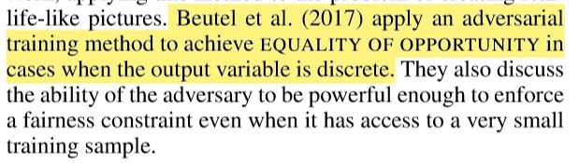
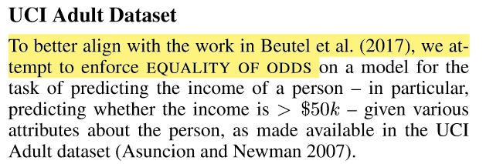
Relation to prior work

Slide 3
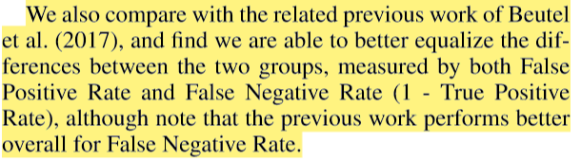
Relation to prior work

Slide 4
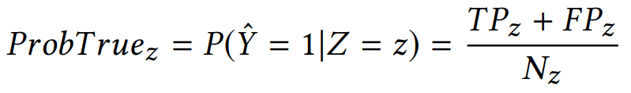
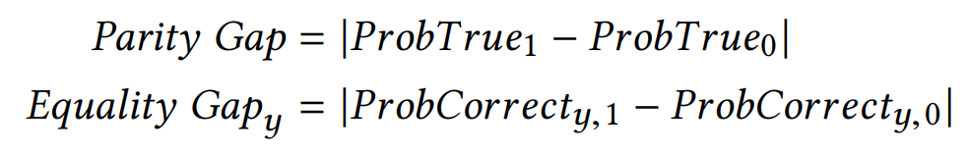
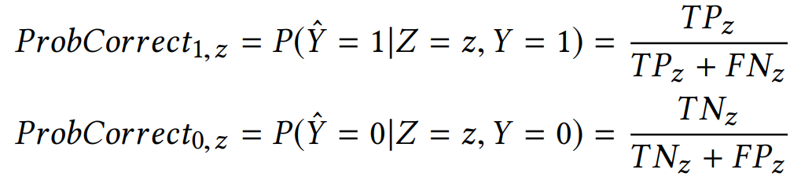
No fairness metrics defined/used
The prior work also introduces metrics for numerically evaluating fairness:
Current work does not evaluate these or the conditional probabilities.
For the UCI dataset, we calculate:
Parity gap ≈ 0.1 → Not that great, base model has parity gap 0.19!
Prior work achieves a parity gap of 0.002 by balancing data w.r.t. Z

Slide 5
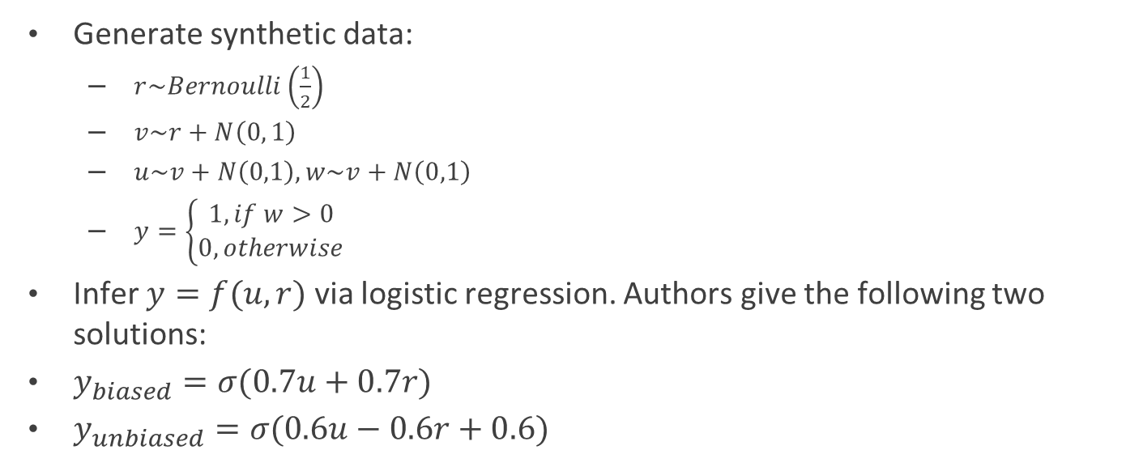
A toy scenario
Generate synthetic data:
$r\sim Bernoulli\left(\frac{1}{2}\right)$
$v\sim r+N\left(0, 1\right)$
$u\sim v+N\left(0,1\right), w\sim v+N\left(0,1\right)$
$y=\left\{\begin{aligned}1, if w>0 \\ 0, otherwise\end{aligned}\right.$
Infer $y=f(u, r)$ via logistic regression. Authors give the following two solutions:
$y_{biased}=σ(0.7u+0.7r)$
$y_{unbiased}=σ(0.6u−0.6r+0.6)$

Slide 6
A toy scenario
Simulated their performance
Classification performance is bad in itself → 73% biased, 69% unbiased.
Still, simulating over 1,000,000 examples leads to very good increases in the two metrics from [Beutel ‘17]:
Parity gap: 0.42 vs 0.001
Equality gap: 0.29 vs 0.05
Very good improvement!
Unfortunately, quantification is missing from paper!

Slide 7

Training and stability
Training adversarial models is notoriously unstable [Arjovski ‘17], especially with hyper-parameter tuning added.
Extra projection term added:
Costs 1 inner product + 2-norm computation per mini-batch.
No other comments on it?
Not essential part of proofs.
Effect of it missing is not quantified.
Does it help stability? No references to prior work.

